Slide 1
Layout and Positioning
Using <div> and <span> elements

Slide 2
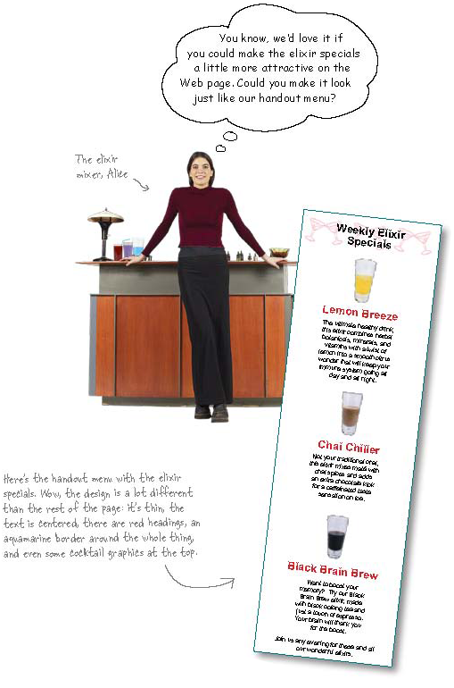
Weekly Elixir Specials
When we finished with the last version of the HeadFirst Lounge we were only half way done the changes that the people at HeadFirst wanted us to complete.
Now, we need to look at moving the portion of the page containing the Weekly Elixir Specials to a separate location and then we will need to apply some styles.

Slide 3
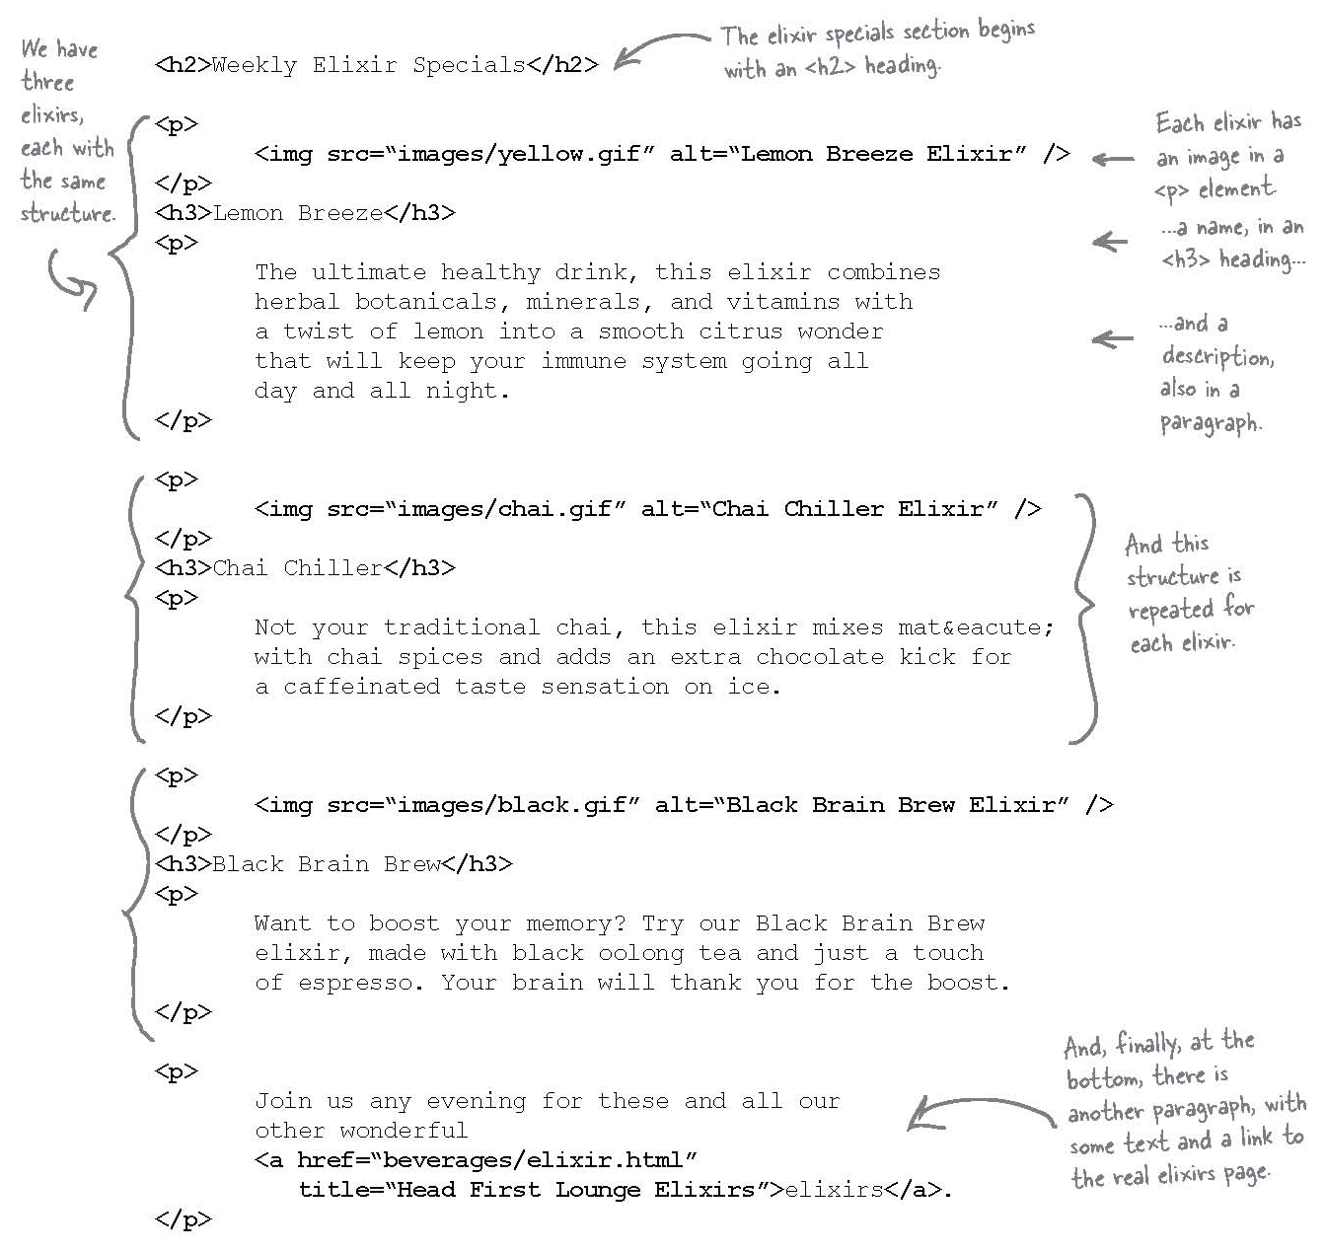
A close look at the elixirs html

Slide 4
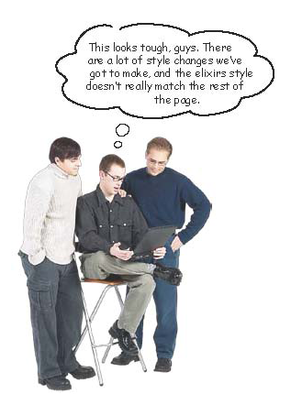
How do we Apply some new style only to the weekly elixirs specials?
Question
Could place a <p> element around the whole Weekly Elixir Specials section and apply a style to that specific paragraph?
Answer
No. Because <p> can not contain other block elements and the other headings and paragraphs are other block elements.

Slide 5
Using a <div> to divide your page into logical sections
Although we are unable to surround block elements with a paragraph tag we are able to use something called a <div> element that will allow us to encapsulate a section of a page and apply a style to it.
If we consider the Weekly Elixir Specials as a logical section with in the HeadFirst Lounge page then we can surround it with <div> and </div>.

Slide 6
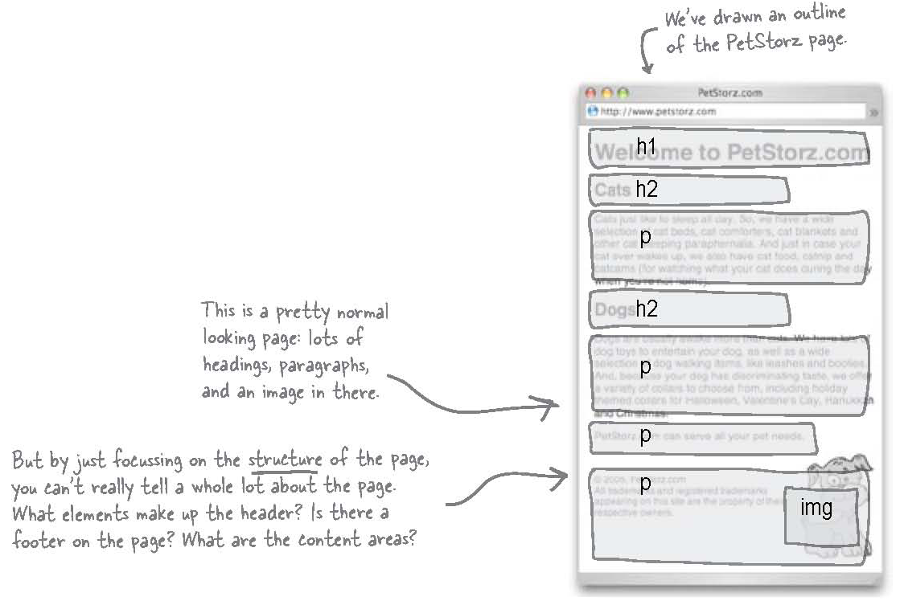
How can we divide our page into Logical Sections
For a few slides, we will consider a different web site for a moment and see how we can divide it into logical sections.
Let’s take a look at the PetStorz.com.

Slide 7
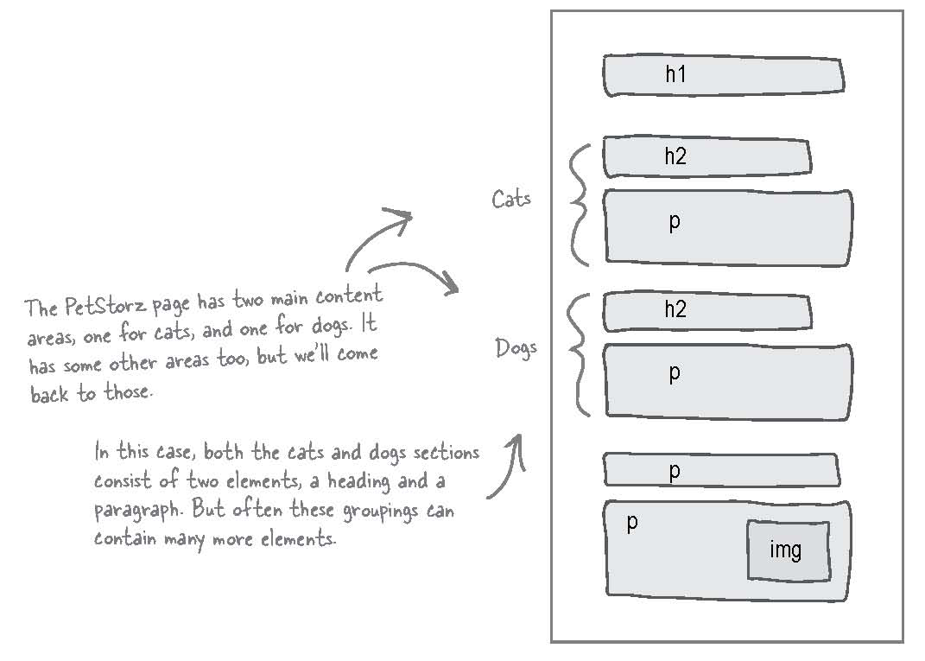
Identifying your Logical Sections
Question
What’s a logical section?
Answer
A group of elements that are related on a page.

Slide 8
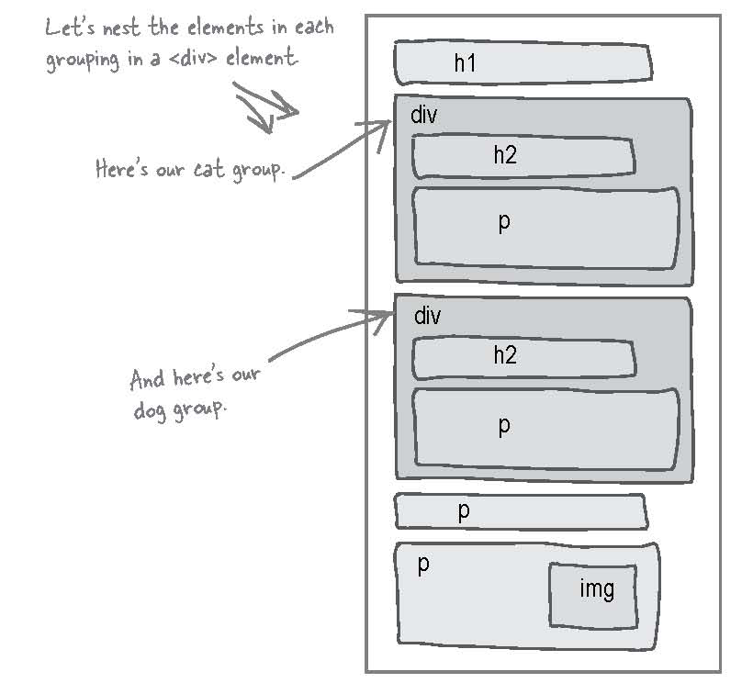
Using <div>s to mark sections
Now that you know which elements (tags) belong to which section you can surround the sections with opening <div> and closing </div> tags.

Slide 9
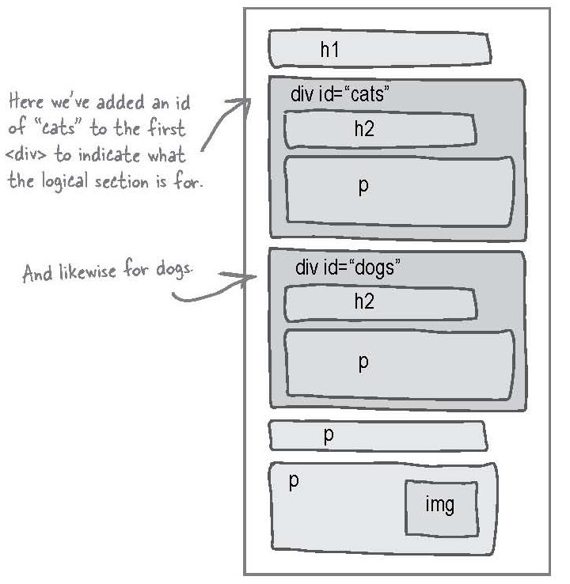
Labelling the <div>s
Question
If great that we divided the page into logical sections but it would definitely help to be able to identify them later. How would we do that?
Answer
Add an id attribute to the div elements that describe the section we have enclosed.

Slide 10
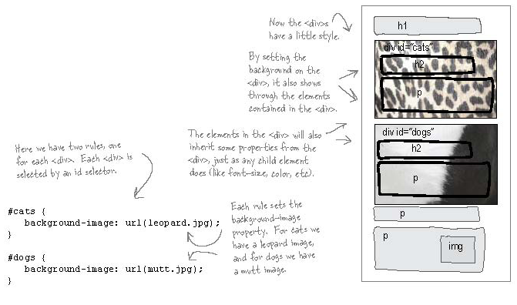
Adding some style to petstorz.com

Slide 11
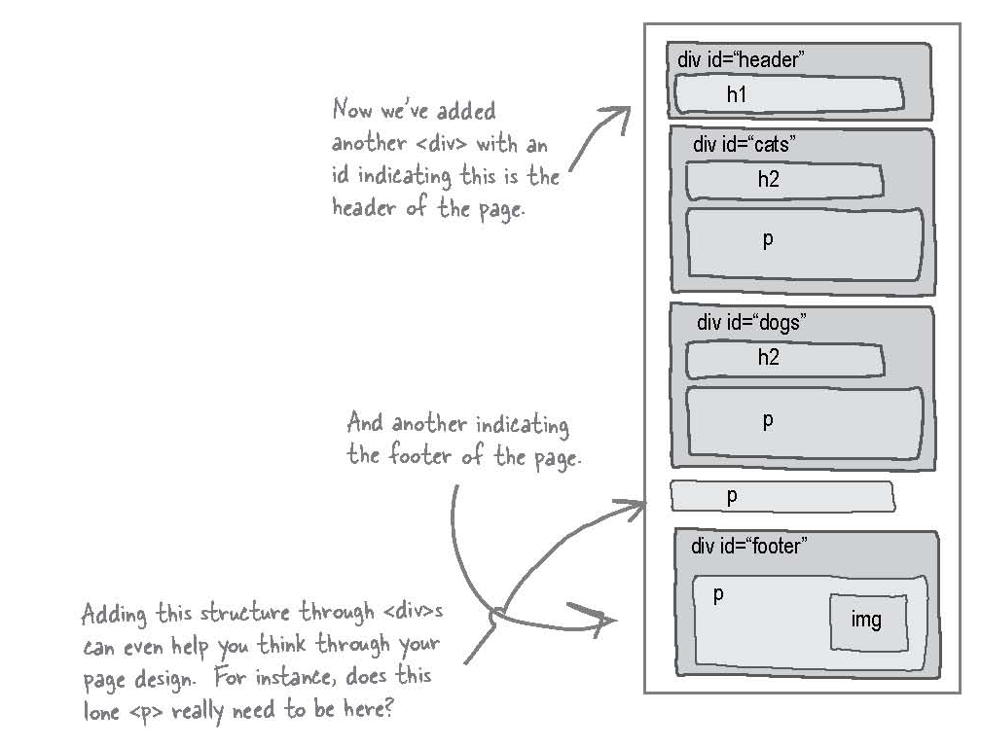
Exposing even more structure

Slide 12
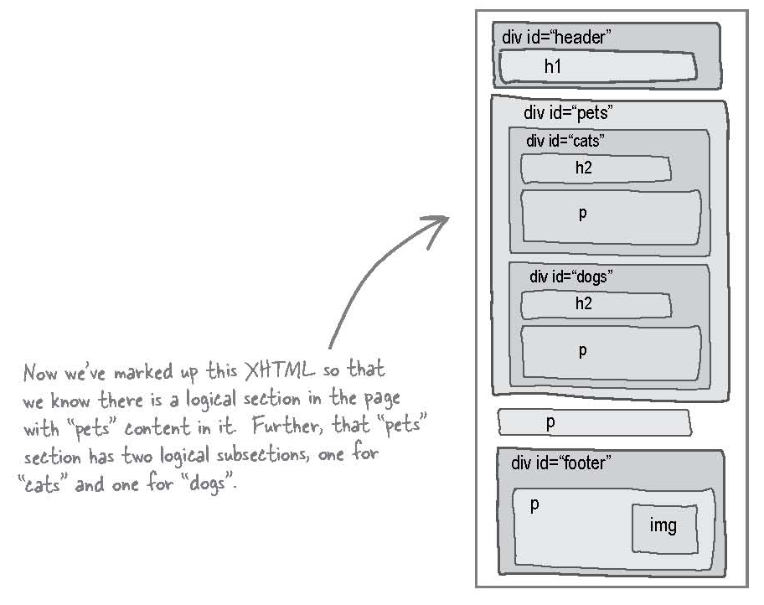
Adding structure on structure
It is common practice to place structures inside other structures.

Slide 13
Questions
Question
So, a <div> acts like a container that you can put elements into to keep them all together.
Answer
It sure does. In fact, we often describe <div>s as “containers”. Not only do they act as logical containers that you can use to hold a bunch of related elements together, but when we start styling <div>s they can act as graphical containers, too.

Slide 14
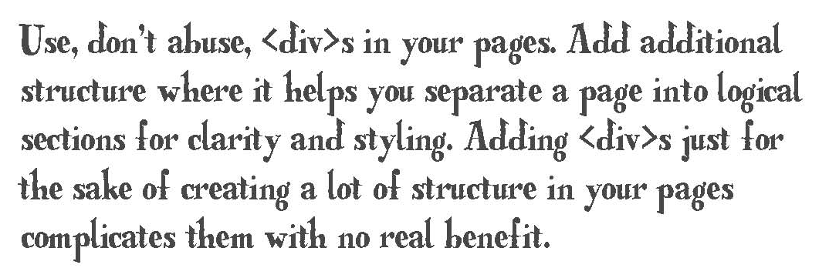
Remember

Slide 15
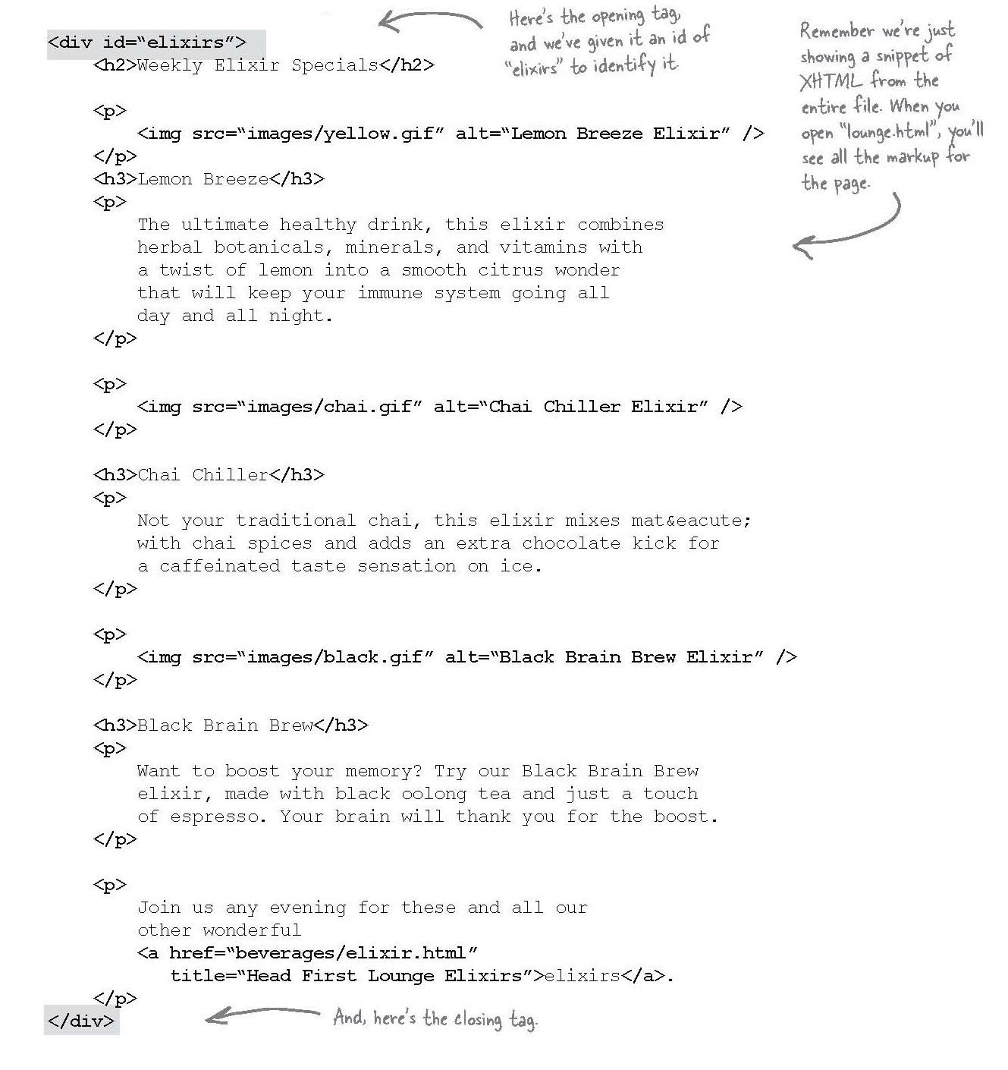
Meanwhile, back at the lounge…

Slide 16
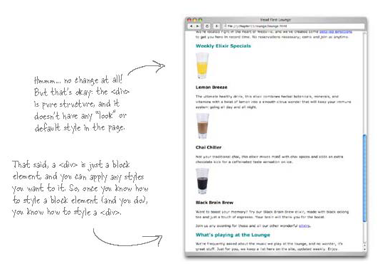
Taking the <div> for a test drive

Slide 17
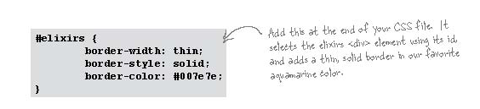
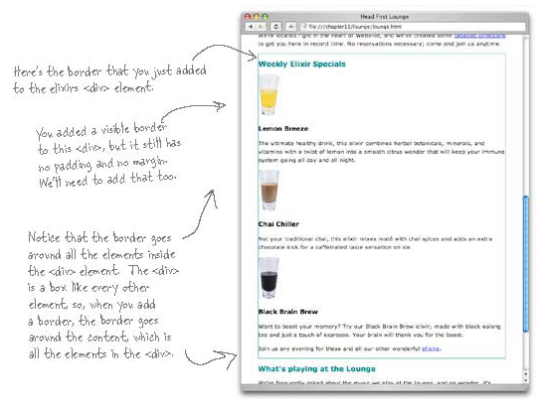
Adding a border

Slide 18
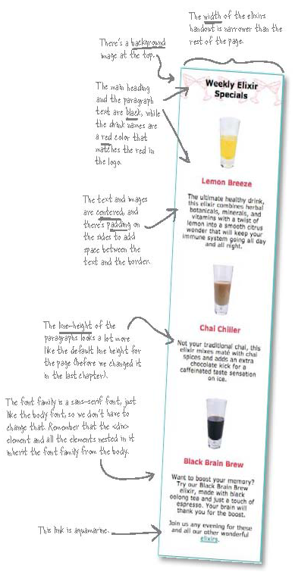
Adding some real style to the elixirs section

Slide 19
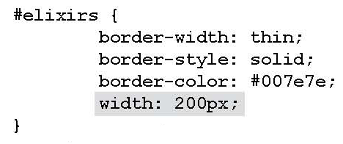
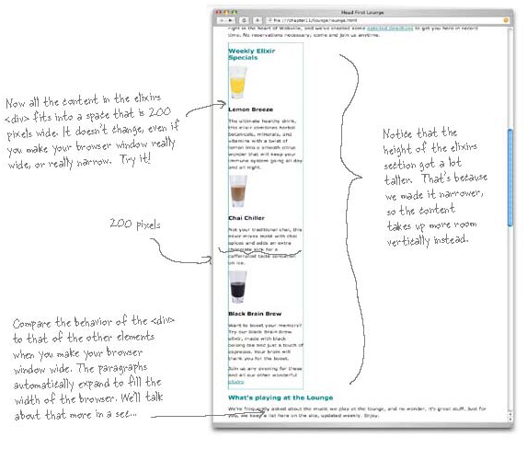
Working with the elixir width

Slide 20
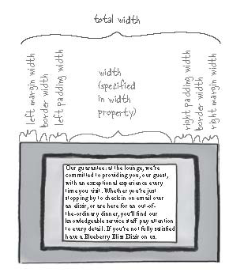
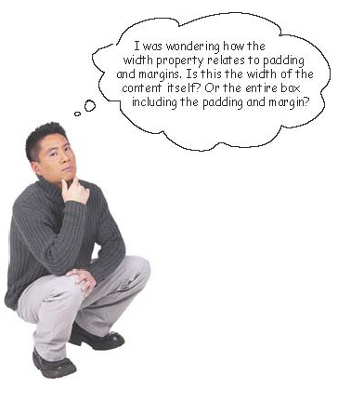
The width property
The width property specifies the width for the content area only.

Slide 21
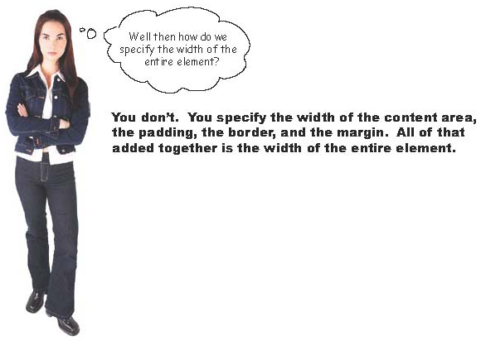
The width property

Slide 22
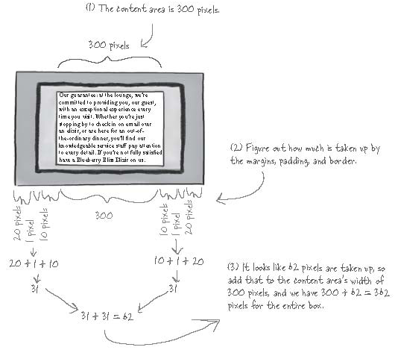
The width property

Slide 23
Questions
Question
If I don’t set the width of an element, then where does the width some from?
Answer
The default width for a block element is “auto”, which means that it will expand to fill whatever space is available.

Slide 24
Questions
Question
What if I don’t have any margin, padding, or borders?
Answer
Then your content gets to use the entire width of the box. If the width of the box is 300 pixels, and you have no padding, border, or margin, then the width of the entire box would also be 300 pixels.

Slide 25
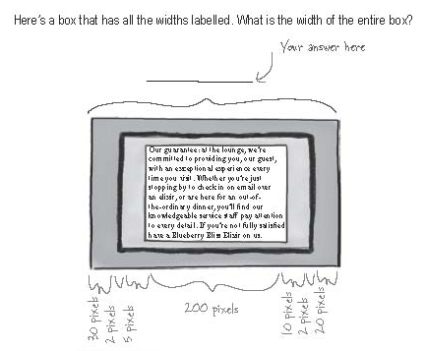
Exercise

Slide 26
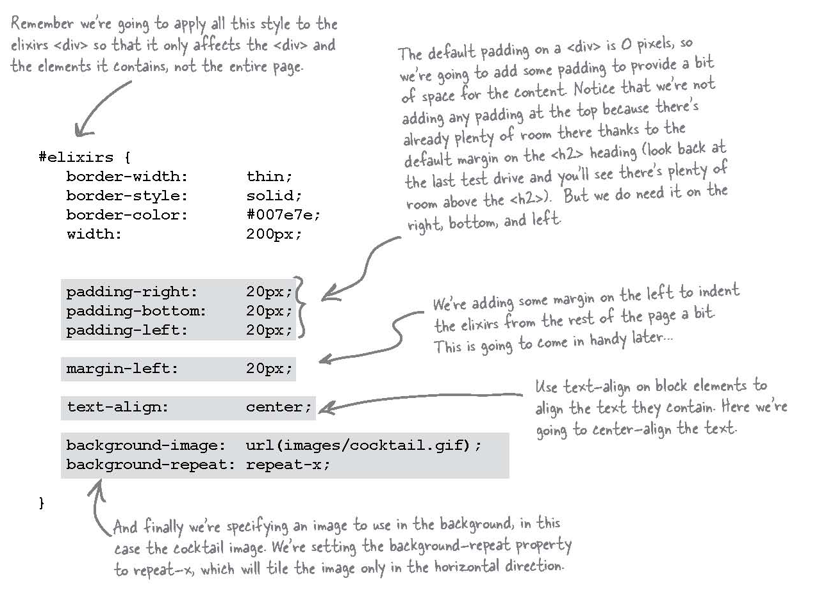
Adding the basic styles to the elixirs

Slide 27
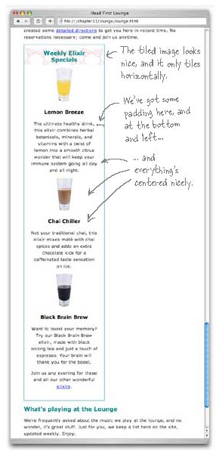
Test driving the new styles
Question
Does the text-align property affect only the alignment of text?
Answer
No. It affects all the elements inside the <div> block element. That is why the headings and the images are centred as well.

Slide 28
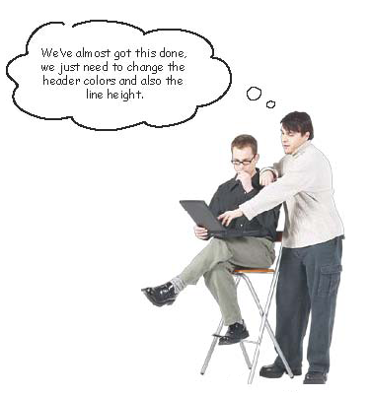
We are almost there…
Question
Can we just create a rule for h2 or h3?
Answer
No. If we change the <h2> rule, or add an <h3> rule, then we’re going to change the heading colours on the entire page. We need to access the <h2> and <h3> inside the <div> tag only.

Slide 29
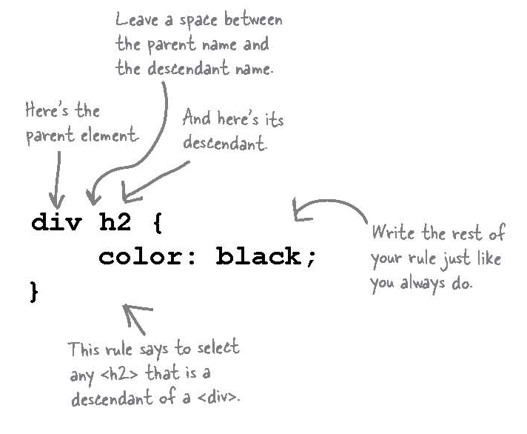
Creating rules for elements inside other elements
To create a rule for <h2> only when it is located inside a div:

Slide 30
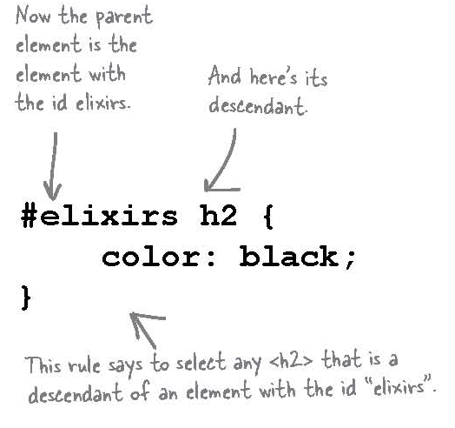
Let’s fix the problem
The last page would create a rule for <h2> for all <div>s. This may not be what we want.
We want to apply the rule to the div element with the id=“elixirs”. We have two options:
div#elixirs h2 {
color: black;
}

Slide 31
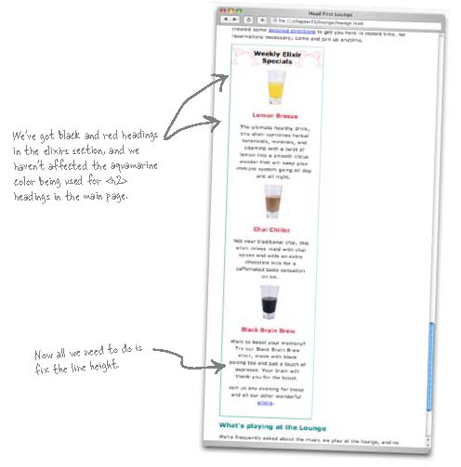
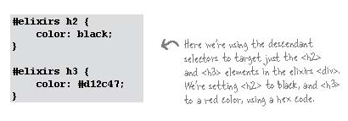
Changing the color of the elixir headings
Let’s go with the second method where we are applying the style to the element that has the elixirs id.

Slide 32
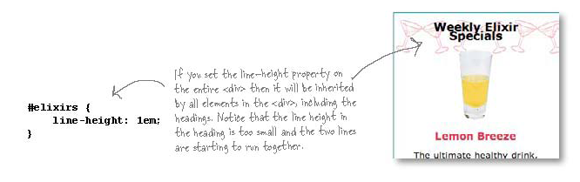
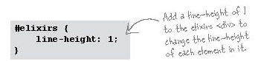
Fixing the line height

Slide 33
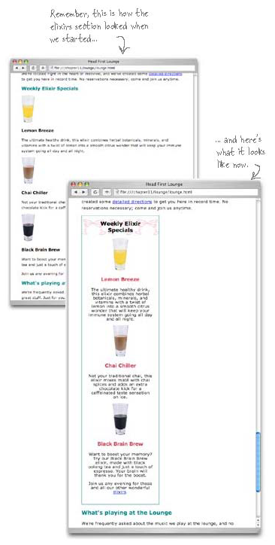
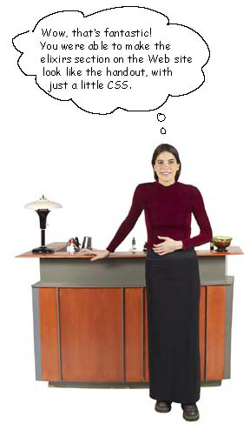
Look what you’ve accomplished…

Slide 34
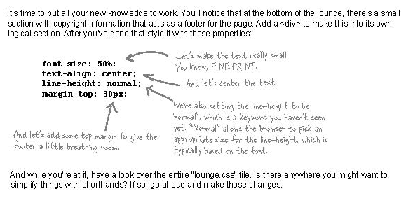
Exercise

Slide 35
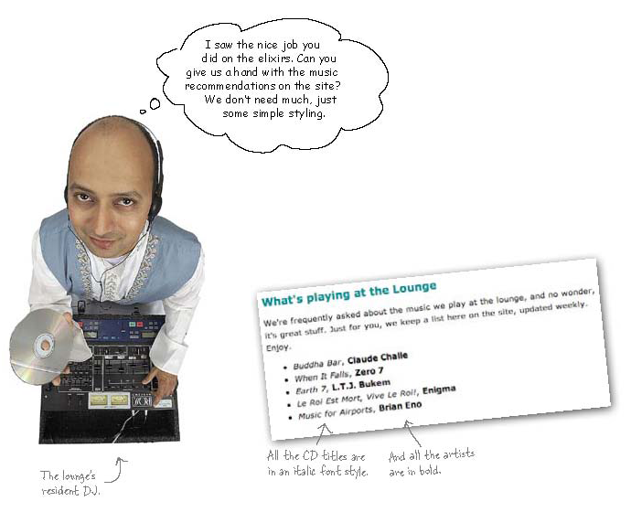
Using <span> instead of <div>

Slide 36
The difference between <span> and <div>
The <span> element is used to group sections of the page just like <div> but it is considered an inline element and not a block element.
An inline element are line up next to each other while block elements are lined up beneath each other.
The <p> element is an example of a block element.
The <img> element is an example of an inline element.

Slide 37

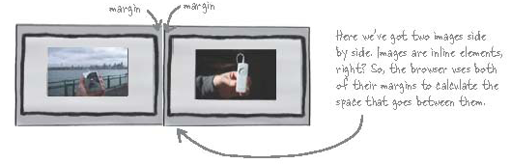

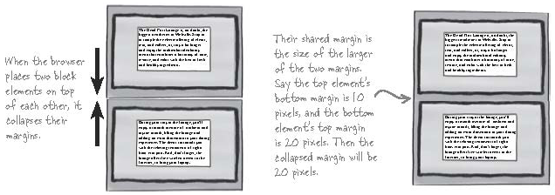
More about Inline vs. block elements

Slide 38
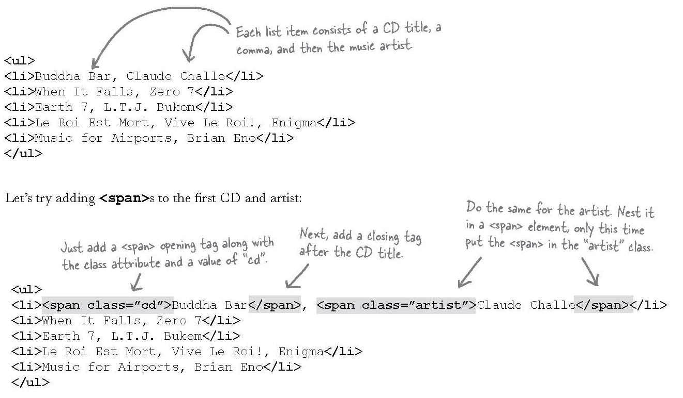
Logical Divisions: <span> vs. <div>
We can create logical sections using either a <div> or <span>, it all depends on whether you need the section to be inline or a block element.

Slide 39
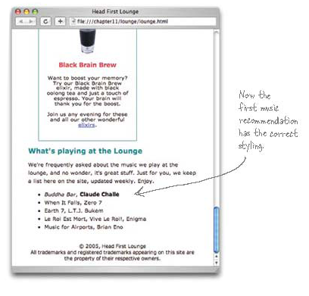
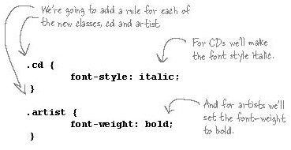

Styling the <span>s

Slide 40
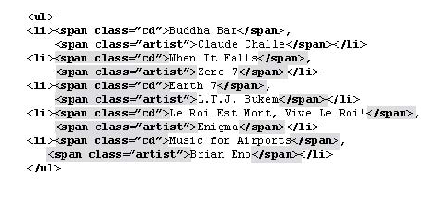
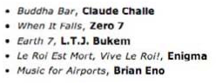
What’s playing at the lounge…

Slide 41
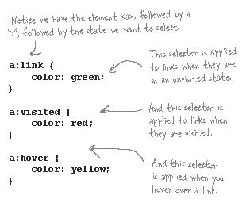
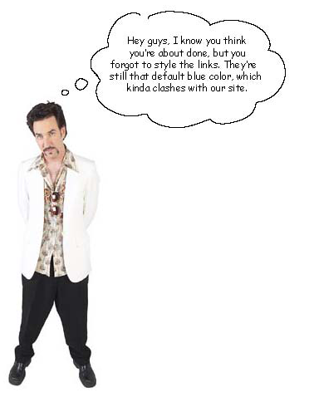
Styling the links

Slide 42
Questions
Question
What happens if I just style the <a> element like a normal element? Like:
a { color: red;}
Answer
You certainly can do that, but then your links will look the same I all states, which makes your links less user-friendly because you can’t tell which ones you’ve visited and which ones you haven’t.

Slide 43
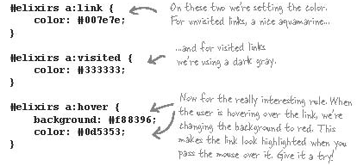
Let’s make sure that only the weekly elixir specials have the new link style

Slide 44
Flow and The Float Property
Browsers place elements in a page using flow.
Block elements flow from top down to the bottom, with a line break between elements.
Inline elements flow inside a block element from the top left to the bottom right. If more than one line is needed the browser creates move them to the next line.

Slide 45
Flow and The Float Property
Floated elements are taken out of the normal flow and placed to the left or right.
Floated elements sit on top of block elements and don’t affect their flow.
The inline elements respect the boundaries of the a floated element and flows around it.

Slide 46
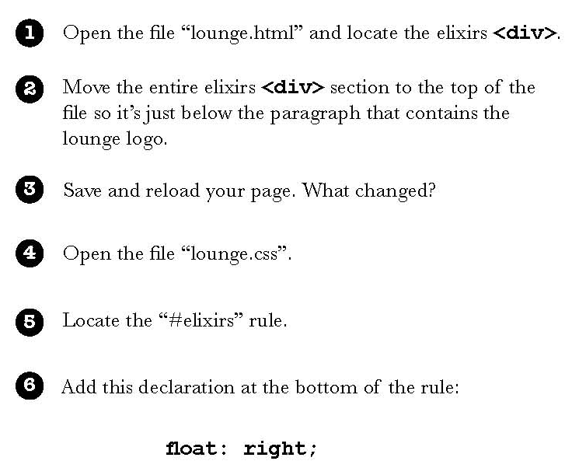
Finish the HeadFirst Lounge

Slide 47
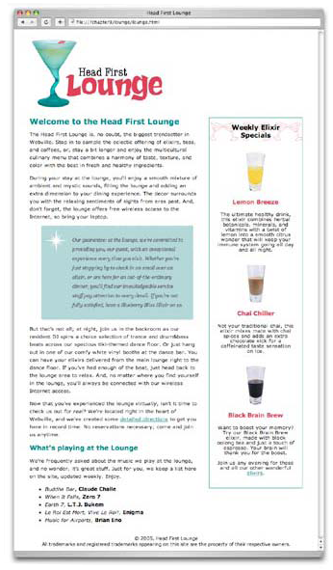
Excellent Job!
Now, you know how to create different logical sections and add different style using CSS.

